Slide 1
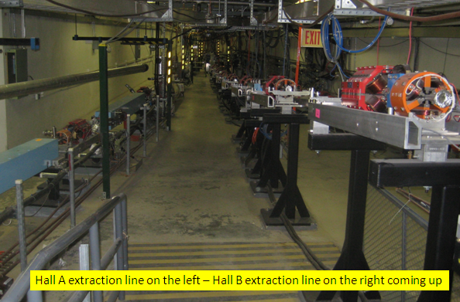
Beamline update
Ken Moffeit 5 June 2013
Overview of the beamline
Beam diagnostics
Silicon Protection
New options for location of HPS
The Beginning
Beamlines to
Hall A Hall B
Beamline upstream of Hall B tagger magnet has a few modifications for higher energy. The beam line will be commissioned to the tagger magnet beam dump in the summer of 2014

Slide 2
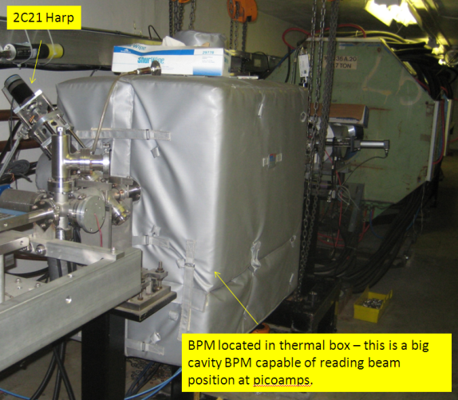
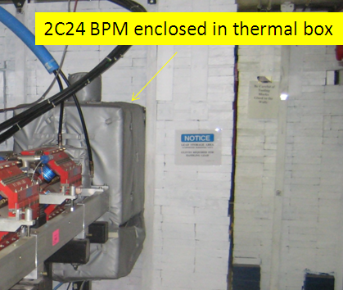
Beam Diagnostics
Beam position and current using BPMs for fast feedback loop (fast is ~ 1 sec)
two sets of cavity beam position monitors (BPMs)
corrector dipoles and quadrupoles
A pair of BPMs, 2C21 and 2C24
fast feedback loop
Beam position and current will be controlled using two sets of cavity beam position monitors (BPMs), that are located in the upstream tunnel. Sets of corrector dipoles and quadrupoles are routinely used to tune the beam for Hall B (2C21 to 2C24). A pair of BPMs, 2C21 and 2C24, will define the incoming trajectory of the beam and are included in the fast feedback loop. Readings from these BPMs will be used to maintain stable beam positions and currents. The stability of beam positions at two different locations also ensures the stability of the beam inclination.

Slide 3
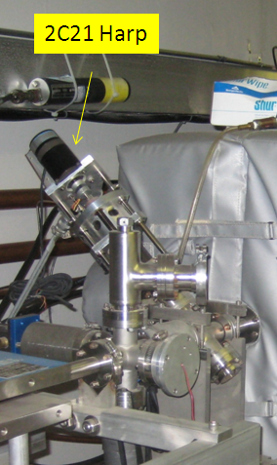
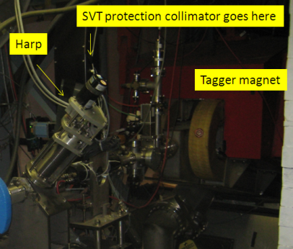
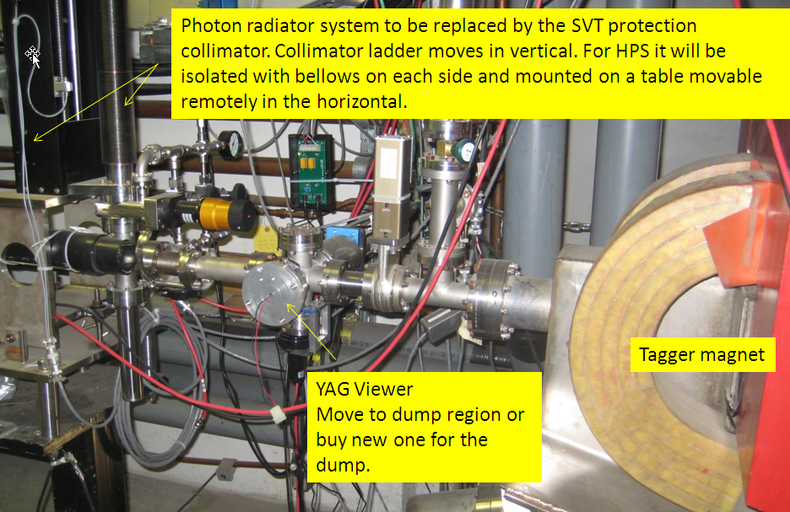
Wire Scans using tagger harp 2c24
Three wire scanners
2C23
2c24 harp = tagger harp
third wire harp, 2H00 harp
The beam profile will be measured using three wire scanners (two are installed in the tunnel, the first one at 2C23, and the second one before the Hall-B tagger magnet, 2C24 harp = tagger harp, about 8 meters upstream of the HPS target. The third wire harp, 2H00 harp, will be located just before the first chicane dipole). The first two profilers will be used to establish the required beam parameters during the initial setup. The Hall-B tagger magnet will be energized when beam tune is in progress, diverting the beam away from the HPS apparatus. After an acceptable beam profile is achieved, the tagger magnet will be degaussed and turned off, and the beam will be put through the HPS system and the beam profile will be checked using the 2H00 wire harp. The backgrounds in the HPS silicon tracker from beam profiling using the 2H00 harp have been simulated. At 5 nA beam current, the radiation damage is equivalent to about 10 sec. of production beam current on the HPS target .
~1 cm
SVT protection collimator ~1cm W
~1.5mm

Slide 4
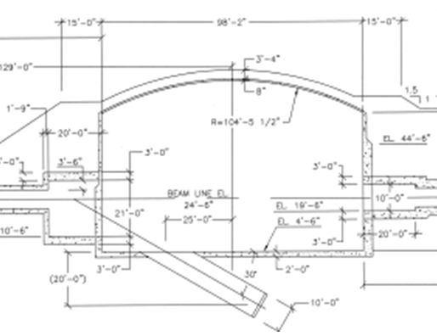
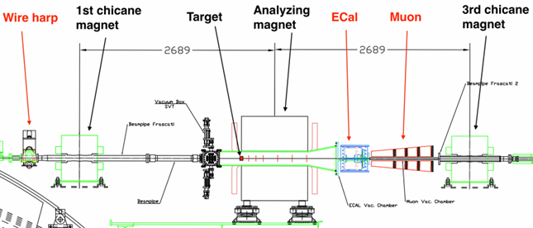
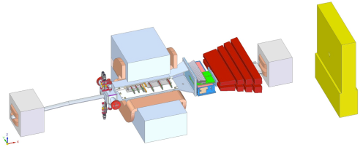
New Options for location of HPS to allow torus installation
Option II: Move HPS to Alcove
Torus Installation
Option I: HPS
Present Location
Option II: HPS
moved to alcove

Slide 5
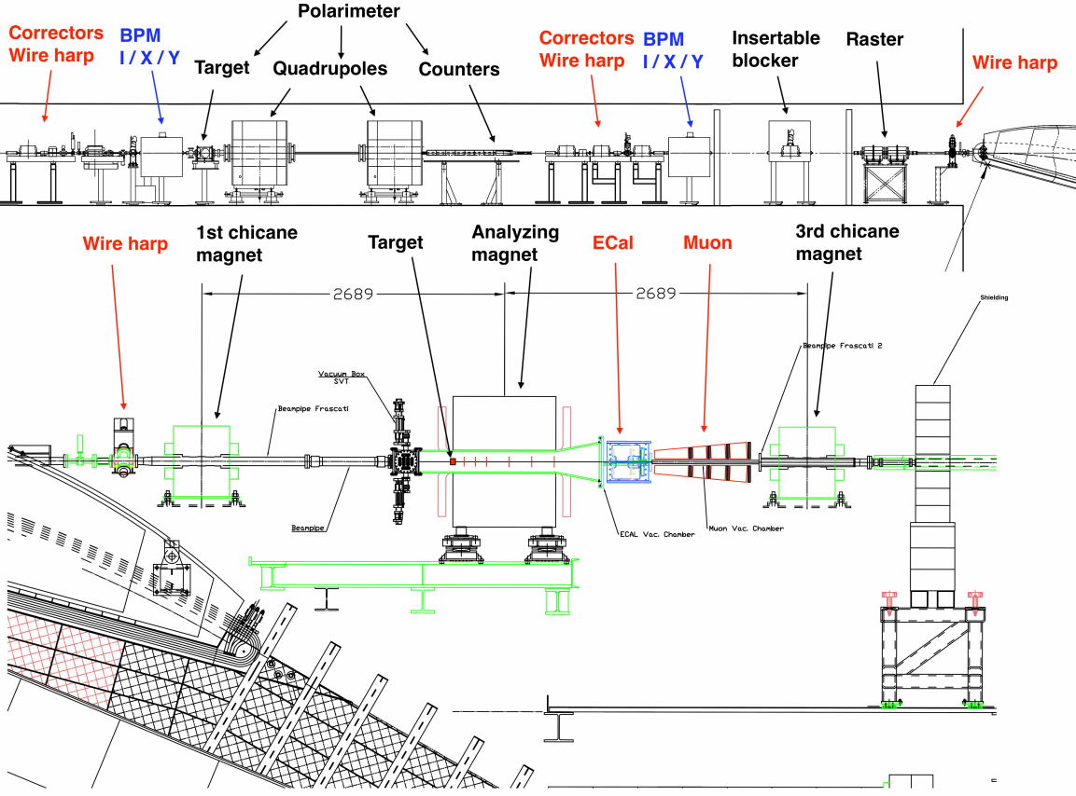
Option I: Beam line configuration for the HPS test run with electron beams.

Slide 6
Option I: Top view of the beam line configuration for the HPS test run with electron beams.
Silicon
ECal
Muon
Shielding
The analyzing magnet is shifted by 11 cm to beam's left for optimal acceptance for both electrons and positrons.

Slide 7
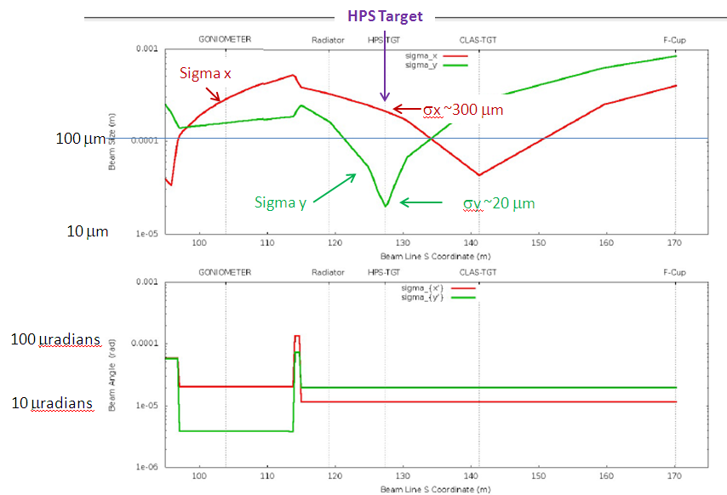
Option I: HPS in Present Location
Beam sizes in X and Y along the B-line in the upstream tunnel and in the region of the HPS test run setup. At the HPS target an asymmetric beam profile X = 300μm and Y = 20μm can be achieved with existing B-line optics.

Slide 8
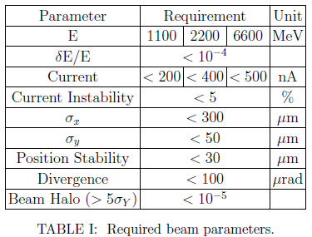
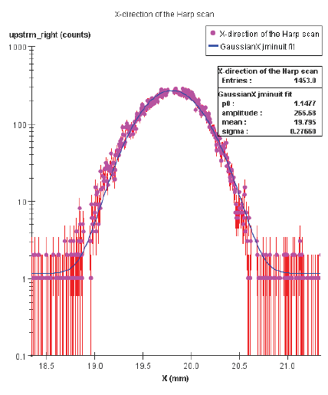
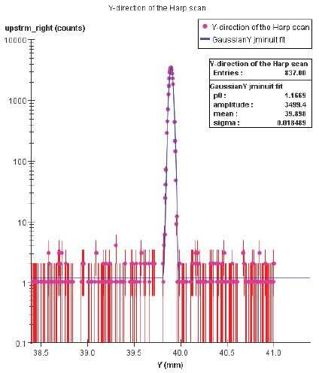
Horizontal direction
Wire harp scan after loading optics parameters from the ELEGANT program. The wire
scan speed was 0.1mm/s, readout speed is 15Hz. Based on the width of the Y-profile, the beam position stability is < 20μm. Note: any beam motion with more than 10 μm amplitude and faster than 1Hz is included in the scan.
Horizontal HPS Collimator width ~1 cm
~1 cm
~1.5mm
Vertical direction
SVT protection collimator
~1cm thick tungsten
Located before tagger magnet
Vertical HPS Collimator height ~1.5 mm

Slide 9
Option II: Pair Spectrometer and Two Frascati Magnets
in Hall B Downstream Alcove
Section View
Plan View

Slide 10
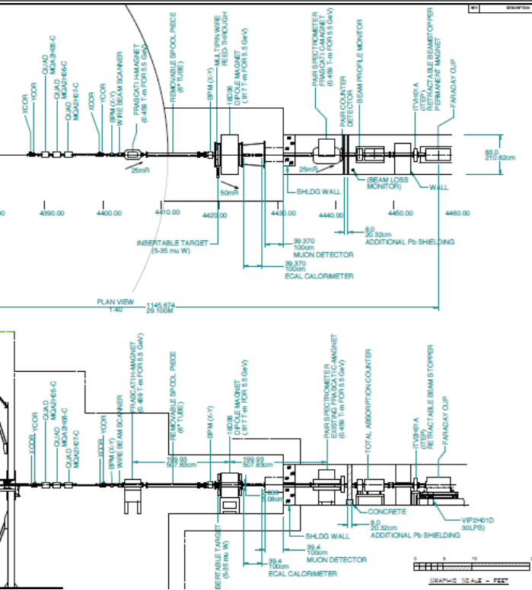
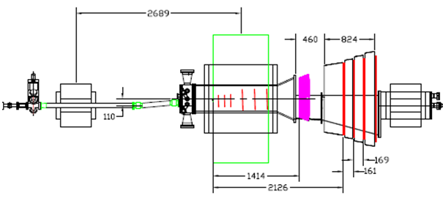
Option II: Move to Alcove
SVT protection collimator moved to beginning of alcove.

Slide 11
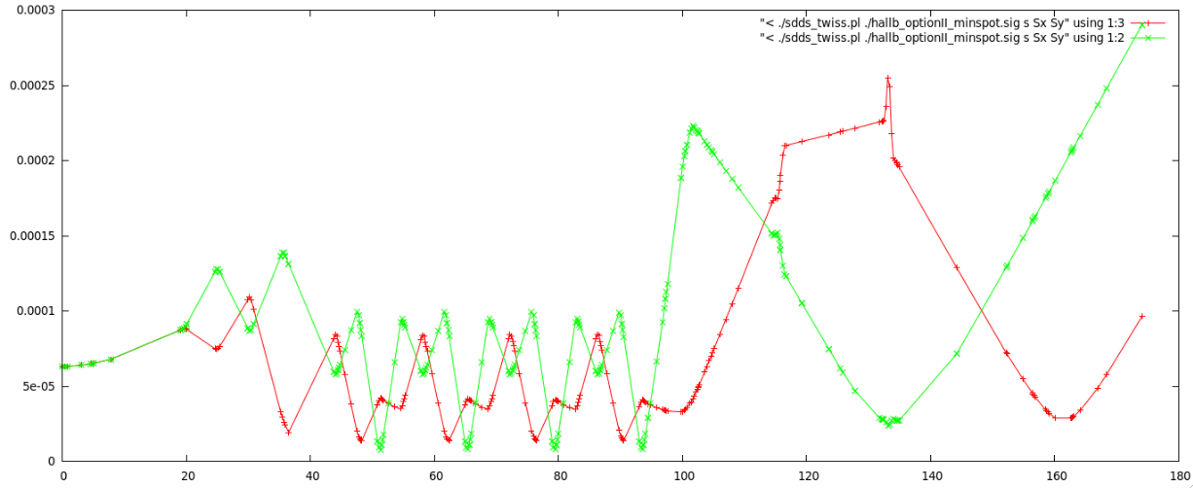
Option II: HPS in Alcove (work by Arne Freyberger)
Location of girder with 3 new HPS quads, 2 correctors and BPMs
- On the space frame just downstream of the 2H01 nA BPM and upstream of the HPS target
The 3-HPS quads and the other nominal quads in the B line
- Used to optimize the beam size at HPS.
HPS location at S = 162.8 meters
sigma_x 206 microns
sigma_y 29 microns
HPS
50 μm
New HPS quads are at S=133.4

Slide 12
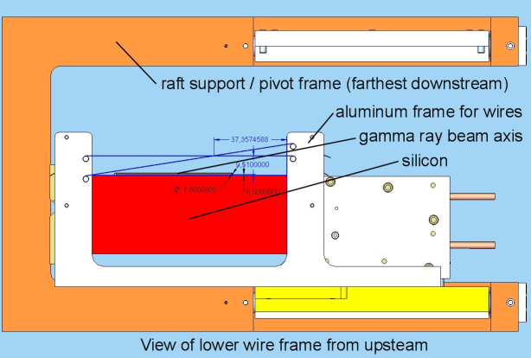
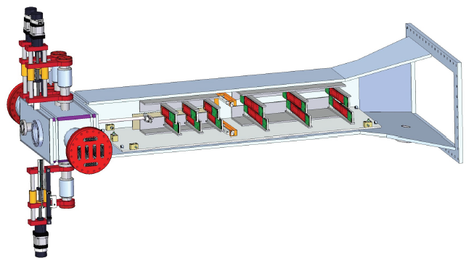
HPS Tungsten wires attached to the upper and lower plates holding the silicon detectors
horizontal wire, 20 micron diameter
30 micron wire at 9 degrees to the horizontal
mounted on a frame attached to the upper movable silicon support plate, and similarly for the bottom plate
frames for the wires are wide enough that they do not occlude the silicon active area
the vertical separation between the front silicon sensor and its nearest wire is 8mm
A set of tungsten beam-fiducial wires will be installed immediately in front of the silicon detectors in the experiment's analyzing magnet. One horizontal wire, 20 micron diameter, and one 30 micron wire at 9 degrees to the horizontal, will be mounted on a frame attached to the upper movable silicon support plate, and similarly for the bottom plate. The frames for the wires are wide enough that they do not occlude the silicon active area. The wires can be used to locate the position of the beam relative to the silicon. To accomplish this safely, the vertical separation between the front silicon sensor and its nearest wire is 8mm. This separation, and the small wire diameters, also means that, when the sensors are positioned for data taking, the wires will have a negligible effect on acceptance. The wires are also available for use as a fairly conventional wire scanner. In particular they can provide information about the minor and major axes, and the tip angle (roll), of a strongly elliptical beam.

Slide 13
YAG Screen
downstream alcove of Hall-B, before the Faraday cup, ~40 meters downstream of the HPS target
An insertable YAG screen beam viewer will be installed in the downstream alcove of Hall-B, before the Faraday cup, ~40 meters downstream of the HPS target. Both the position and profile of the beam will be used to setup the chicane magnets and to monitor beam quality during the run.
Terminate beam (FSD) using Beam Halo Counters and Beam Offset Monitors:
set of beam halo counters mounted along the beam line
beam offset monitor (BOM) will be installed upstream of the 2H00 wire harp
FSD will occur in less than 40 micro sec
A set of beam halo counters mounted along the beam line provides continuous and fast monitoring of the beam conditions. These counters are like those used for beam profile measurements. Excess noise in the beam halo counters triggers the machine fast shutdown system (FSD) in order to terminate beam in the event of beam excursions which could damage the HPS detectors. The FSD will occur in less than 40 micro sec.
In addition to halo counters, a beam offset monitor (BOM) will be installed upstream of the 2H00 wire harp. A short quartz cylinder, about 1cm in diameter, with optical fibers attached around the edge, will be centered on the beam. Even a few electrons in the beam tail will generate light in the cylinder that will be detected in a multi-anode PMT attached to the readout fibers. Errant beam motion towards the collimator located upstream of the tagger magnet will generate more light and increase the counts in the quartz cylinder, signaling a potential problem. The BOM will be wired to FSD as part of the equipment protection system.

Slide 14
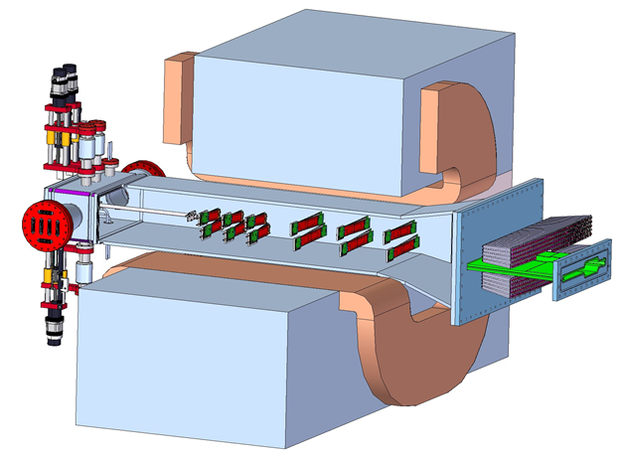
Vacuum chambers
SVT vacuum box will be attached to the existing magnet vacuum chamber as shown on the figure. Power, high voltage, and data signals to and from the hybrids are connected through two 8" flanges on the sides of the vacuum box.
A third linear motion mechanism is used to position the target on or off the beam.
Two vertical linear motion mechanisms driven by stepper motors are used to position the SVT upper and lower modules with a precision of 1.25 μm/step (or ~0.4 μm movement of silicon layer 1.)

Slide 15
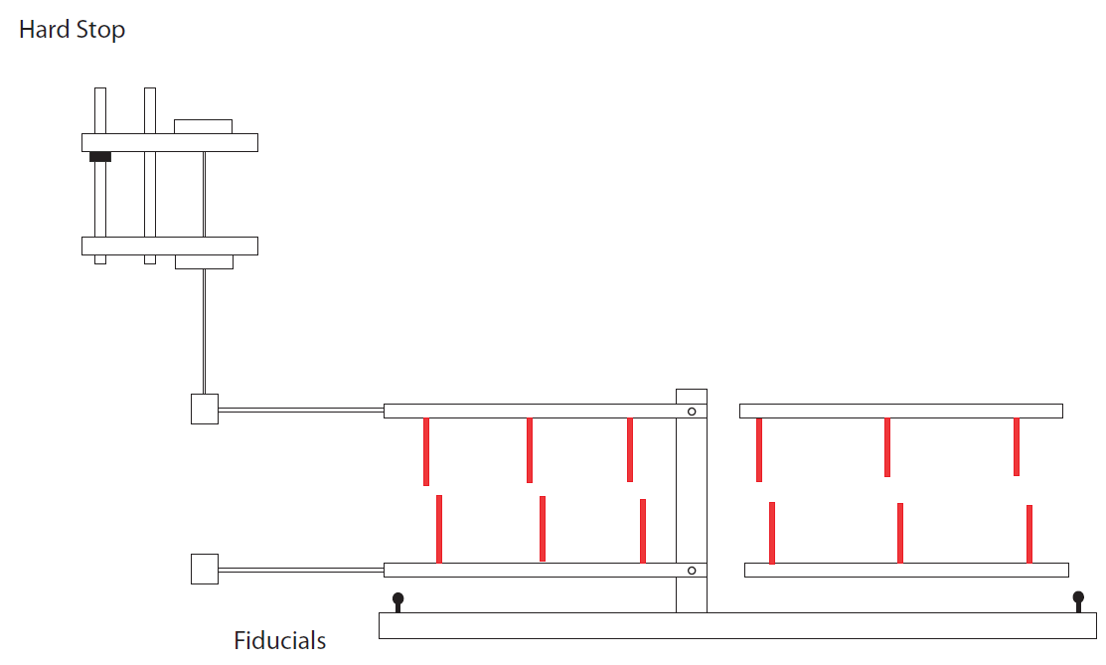
SVT Alignment
GOAL: Place SVT in the nominal beamline within 100 microns.
The sensors can be placed in the support plate within 50 microns.
The 15 mrad dead zone is set when the support plate is horizontal.
Make sure there is no sag in the support plate.
SVT support plates are set parallel to the base plate.
Make sure there is no sag in the base plate.
SVT sensor positions can be known within 50 microns relative to the fiducials on the base plate.
All four fiducials must be visible from front and back of the magnet.
Flex joint connection may not be reproducible.
Two flanges on the linear stage may have ~100 microns height uncertainty.
Hard stop is set in situ so that the edge of the first layer sensor is 400microns from the beam.
Make the support plates and the base plate parallel.
Move the linear stage so that the sensor edge is closer to the beam by 100microns.
Flex joint

Slide 16
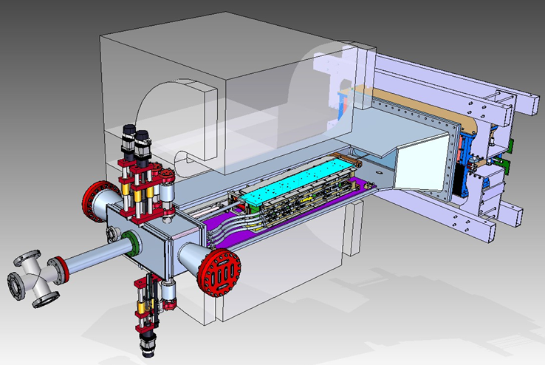
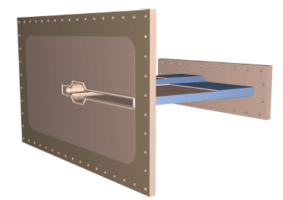
ECal Vacuum Chamber
The scattering chamber between the top and bottom parts of the ECal is a critical beamline element. The front flange of the chamber connects directly to the magnet vacuum chamber. Vacuum is maintained only on the electron side (beam right) since the backgrounds on the positron side are negligible. In order to avoid excessive deformation of the thin walls of the vacuum chamber, an aluminum honeycomb support is inserted between the upper and lower walls, to beam's right.

Slide 17
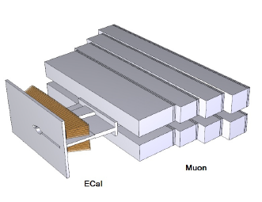
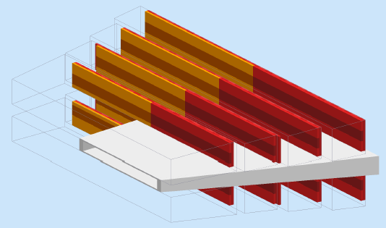
Muon system vacuum
The ECal vacuum chamber will be connected to the muon system vacuum chamber, located between the two halves of the muon system. At its upstream end, the muon vacuum chamber will have a gap of 5 cm. At the downstream end that gap will be 7.5 cm.
The last vacuum chamber
passes through the third dipole, does not need to have a narrow opening. Its size is that of the Frascati H magnet gap. At the downstream end of this chamber, there will be flange with two exit windows, a Kapton window for the photon beam to exit the chamber and go to the photon beam dump through a Helium bag, and a vacuum continuation to the standard beam line for the electron beam to go to the Hall-B electron beam dump.

Slide 18
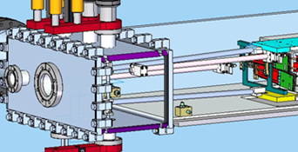
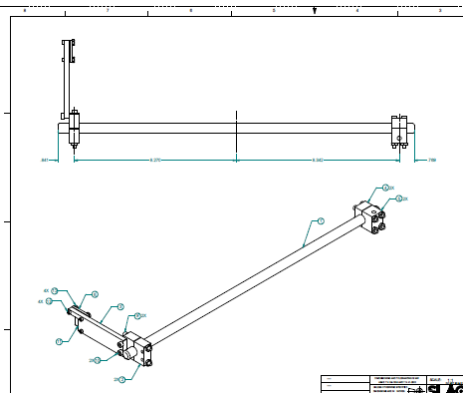
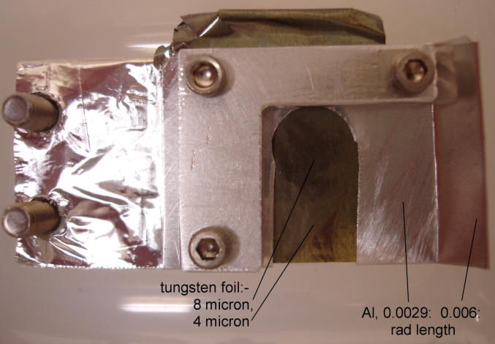
Targets
thin tungsten foil
target is located 10 cm in front of the first plane of silicon strip detectors
primary target, 10 mm square, is 0.00125 radiation lengths
mounted immediately above it is a similar area of 0.0025 radiation lengths
thin tungsten foil can be fully retracted from the beam
keep the temperature rise less than about 1000 degrees
at 200 nA the rms beam radii will be held above 20 by 250 μm, or 40 by 250 μm for 400 nA.
A thin tungsten foil is used as the target. High Z material is chosen for its short radiation length, to minimize the hadronic production relative to the electromagnetic trident and heavy photon production. The target is located 10 cm in front of the first plane of silicon strip detectors. The primary target, 10 mm square, is 0.00125 radiation lengths (approximately 4 microns tungsten). Mounted immediately above it is a similar area of 0.0025 radiation lengths, available for some of the data taking, adjusting the beam current as appropriate. The foil can be fully retracted from the beam, and is inserted on to the beam line from above, using a stepping motor linear actuator. The bottom edge of the foil is free-standing so there is no thick support frame to trip the beam when the target is inserted. Its position is adjustable vertically allowing either thickness to be selected, and different sections of the tungsten can be used in the event of beam damage. The support frame on the beam-right side of the target is made thin enough to prevent radiation damage to the silicon in the event of an errant beam caused, for example, by an upstream chicane magnet trip. The target is intended to operate with beam currents up to 450 nA, which produce strong local heating. The strength of tungsten drops by an order of magnitude with temperature increases in the range of 1000 C. In addition, the material re-crystallizes above this range, which increases the tendency for cracking where thermal expansion has caused temporary dimpling. For these reasons, it was decided to keep the temperature rise less than about 1000 degrees, which is accomplished by selecting an adequately large beam spot area. For example, at 200 nA the rms beam radii will be held above 20 by 250 microns, or 40 by 250 microns for 400 nA. Simulations have shown that these beam spot sizes do not diminish the pair reconstruction resolution of the experiment.
Assembly drawing showing how the target is hung out in space.

Slide 19
Beam dumps and shieldings
The Hall-B electron beam dump will be used to terminate the electron beam. Due to its high intensity, the beam will not be dumped in the Faraday cup (FC); instead, the existing beam blocker before the FC will be used to terminate the beam. The photon beam will be dumped in a photon beam dump, which will be a hut made of lead bricks located on the space frame. There will be a shielding wall after the last chicane magnet to prevent radiation from reaching the detector systems on the downstream side of the Hall.
Entrance to the downstream tunnel
Hall-B complex from upstream tunnel to dump

Slide 20
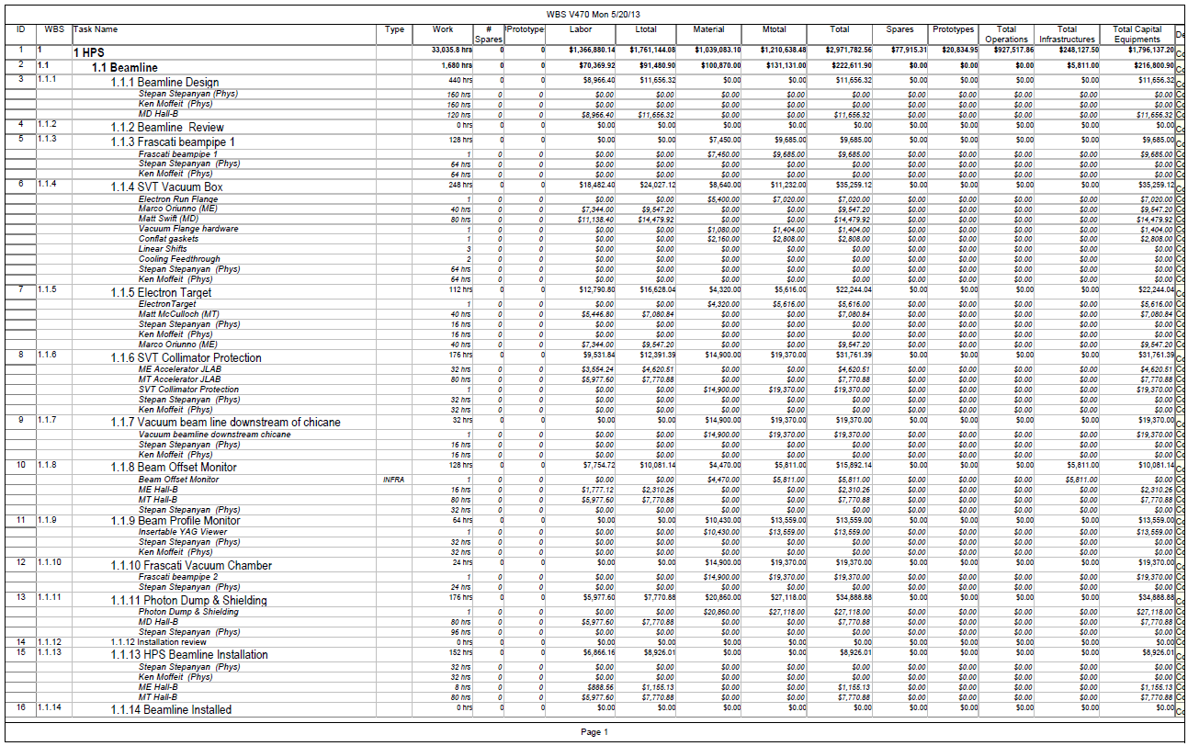
Option I: Beamline work with cost ($216k for HPS beamline items).
Option II: Above costs plus ~ $40k to move HPS to alcove.
(Base, Pair Spec Base, Frascati magnets…)
Materials $ 40414
Design 30 days
Engineer 12 days
Technician 6 days

Slide 21
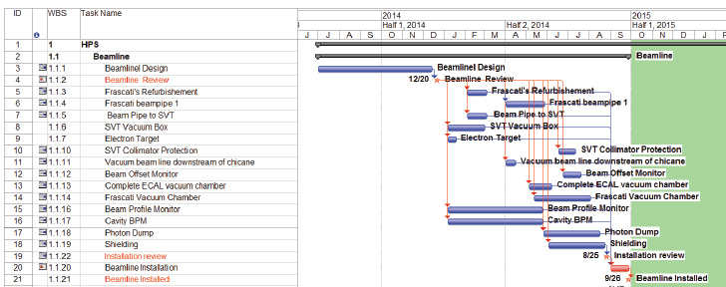
Schedule for running HPS in 2014 and 2015 with Beamline commissioned in summer 2014.
Option I:
Install Sep/Oct 2014 as shown below
Commission HPS running nights and weekend when torus work is not being done.
Production HPS running April – June 2015 at end of torus work while torus magnets are cooling down.
Option II:
Move chicane magnets to alcove during the summer of 2014
Install silicon, ECal and muon detectors in September 2014.
Commission HPS during Fall 2014 running nights and weekend when torus work is not being done. No activation of small diameter beam pipe through torus or torus elements because beam is clean.
Production HPS running April – June 2015
Longer production HPS running July – December 2015

Slide 22
Option II: Installation Plan in Alcove (Bob Miller – 31 May 2013)
Assemble portable deck on Hall floor up against downstream alcove
Locate base I beams on alcove floor and portable deck
Mark floor for I beam to floor attachments
Drill floor and install inserts
Set I beams level and coplanar
Grout I beams to floor and deck
Set 4 Hilman rollers on I beams
Set Frascati stand on Hilman rollers
Set Frascati magnet onto stand and secure
Move Frascati magnet and stand into position, lock in place
Set 4 Hilman rollers on I beams
Set PairSpec base on Hilman rollers
Install PairSpec adjustment system on base, secure adjusters in place
Install PairSpec on adjustment system
Move PairSpec into position and secure in place
Set 4 Hilman rollers on I beams
Set Frascati stand on Hilman rollers
Set Frascati magnet onto stand and secure
Move Frascati magnet and stand into position, lock in place
Cut base I beams upstream of Frascati magnet stand
Remove I beams and portable deck

Slide 23
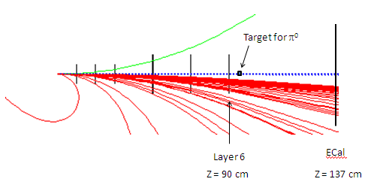
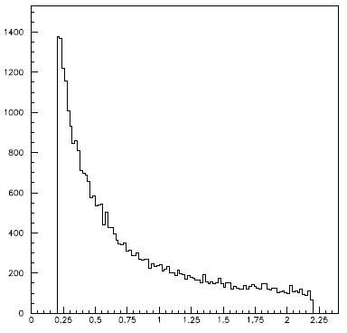
Work in progress
A) Procedures for beam operation.
Activation of torus and small beam pipe with HPS in Option I location
Beam stability and size for HPS in Option II location
Turning on beam initially
Recovery from beam trips
Silicon, ECal, muon detectors installation, survey and alignment procedures
B) Source of pi-zeros for ECal calibration (see talk in ECal section)
C) Beam and beam induced background study in HPS (see next talk by Takashi)
Gamma from 2.2 GeV electrons on target

Slide 24
The End
Dump

